Slide 1
Machine Learning Mini Project Justus Onyango 191948 Caxton Kiptoo 180657 paul gitungo 190093
Comparative Analysis of Machine Learning Models for Predicting Financial Inclusion in East Africa

Slide 2

Problem Identification & Relevance to Africa
Problem
Many people in East Africa still lack access to formal banking services.
Financial inclusion is essential for economic growth and poverty reduction.
Predicting bank account ownership can help policymakers identify financially excluded populations.
Objective
Compare KNN, Decision Tree, SVM, and ANN in predicting bank account ownership.

Slide 3

Dataset Selection & Justification
Dataset
Financial Inclusion in Africa Dataset (Zindi)
23,524 respondents
Kenya, Uganda, Tanzania and Rwanda
Target variable: Bank Account Ownership
Why this dataset?
East African context
Large sample size
Relevant demographic and socioeconomic variables
Suitable for binary classification

Slide 4

Related Work
Study | Key Finding
Ismail et al. (2021) | XGBoost achieved highest accuracy
Adesanya & Emilia (2025) | AI improves financial inclusion
Afrobarometer (2025) | Education & phone ownership influence bank accounts
Wale & Makina (2017) | Socioeconomic factors determine financial inclusion
Research Gap
This study compares KNN, DT, SVM and ANN using Stratified 2-Fold Cross Validation.

Slide 5

Financial Inclusion
in Africa Dataset
│
Data Exploration
(No missing values found)
│
Data Cleaning
(Removed uniqueid)
│
Feature Engineering
(Target Encoding +
One-Hot Encoding)
│
Feature Scaling
(StandardScaler)
│
Final Dataset
(23,524 samples,
40 predictor features)
│
Stratified 2-Fold
Cross Validation
Training Data Construction
Final Dataset
23,524 observations
40 predictor features
Binary target (bank_account)

Slide 6
Machine Learning Models
K-Nearest Neighbors (KNN)
Decision Tree
Support Vector Machine
Artificial Neural Network
Evaluation
Stratified 2-Fold Cross Validation
Accuracy
Precision
Recall
F1-Score
Classification Accuracy Results
Model | Accuracy | Precision | Recall | F1-Score
Artificial Neural Network (ANN) | 0.8862 | 0.6836 | 0.3575 | 0.4695
K-Nearest Neighbors (KNN) | 0.8772 | 0.6139 | 0.3463 | 0.4428
Decision Tree (DT) | 0.8164 | 0.3630 | 0.4025 | 0.3817
Support Vector Machine (SVM) | 0.7922 | 0.3803 | 0.7560 | 0.5060

Slide 7
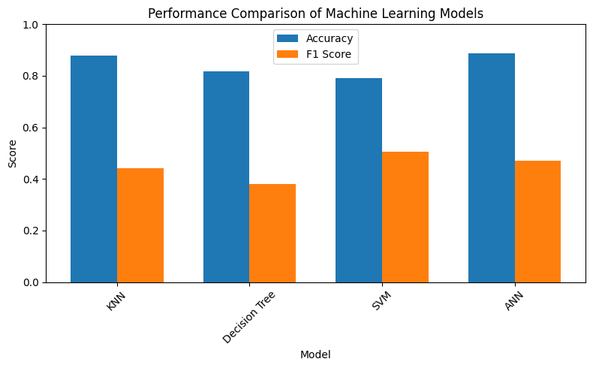
Performance Comparison of Machine Learning Models
Discussion
ANN had the highest overall accuracy(best model).
SVM achieved the highest Recall and F1-score; more effective at identifying bank account owners.
KNN produced competitive performance(second-highest classification accuracy).
Decision Tree showed lower performance.
Dataset imbalance influenced model performance(Recall and F1 Score).

Slide 8
Conclusion
Four machine learning models were evaluated.
ANN produced the highest overall accuracy.
SVM performed best in identifying bank account owners.
Model selection depends on the prediction objective.
Machine learning is effective for predicting financial inclusion.

Slide 9

Thank you

